Slide 1
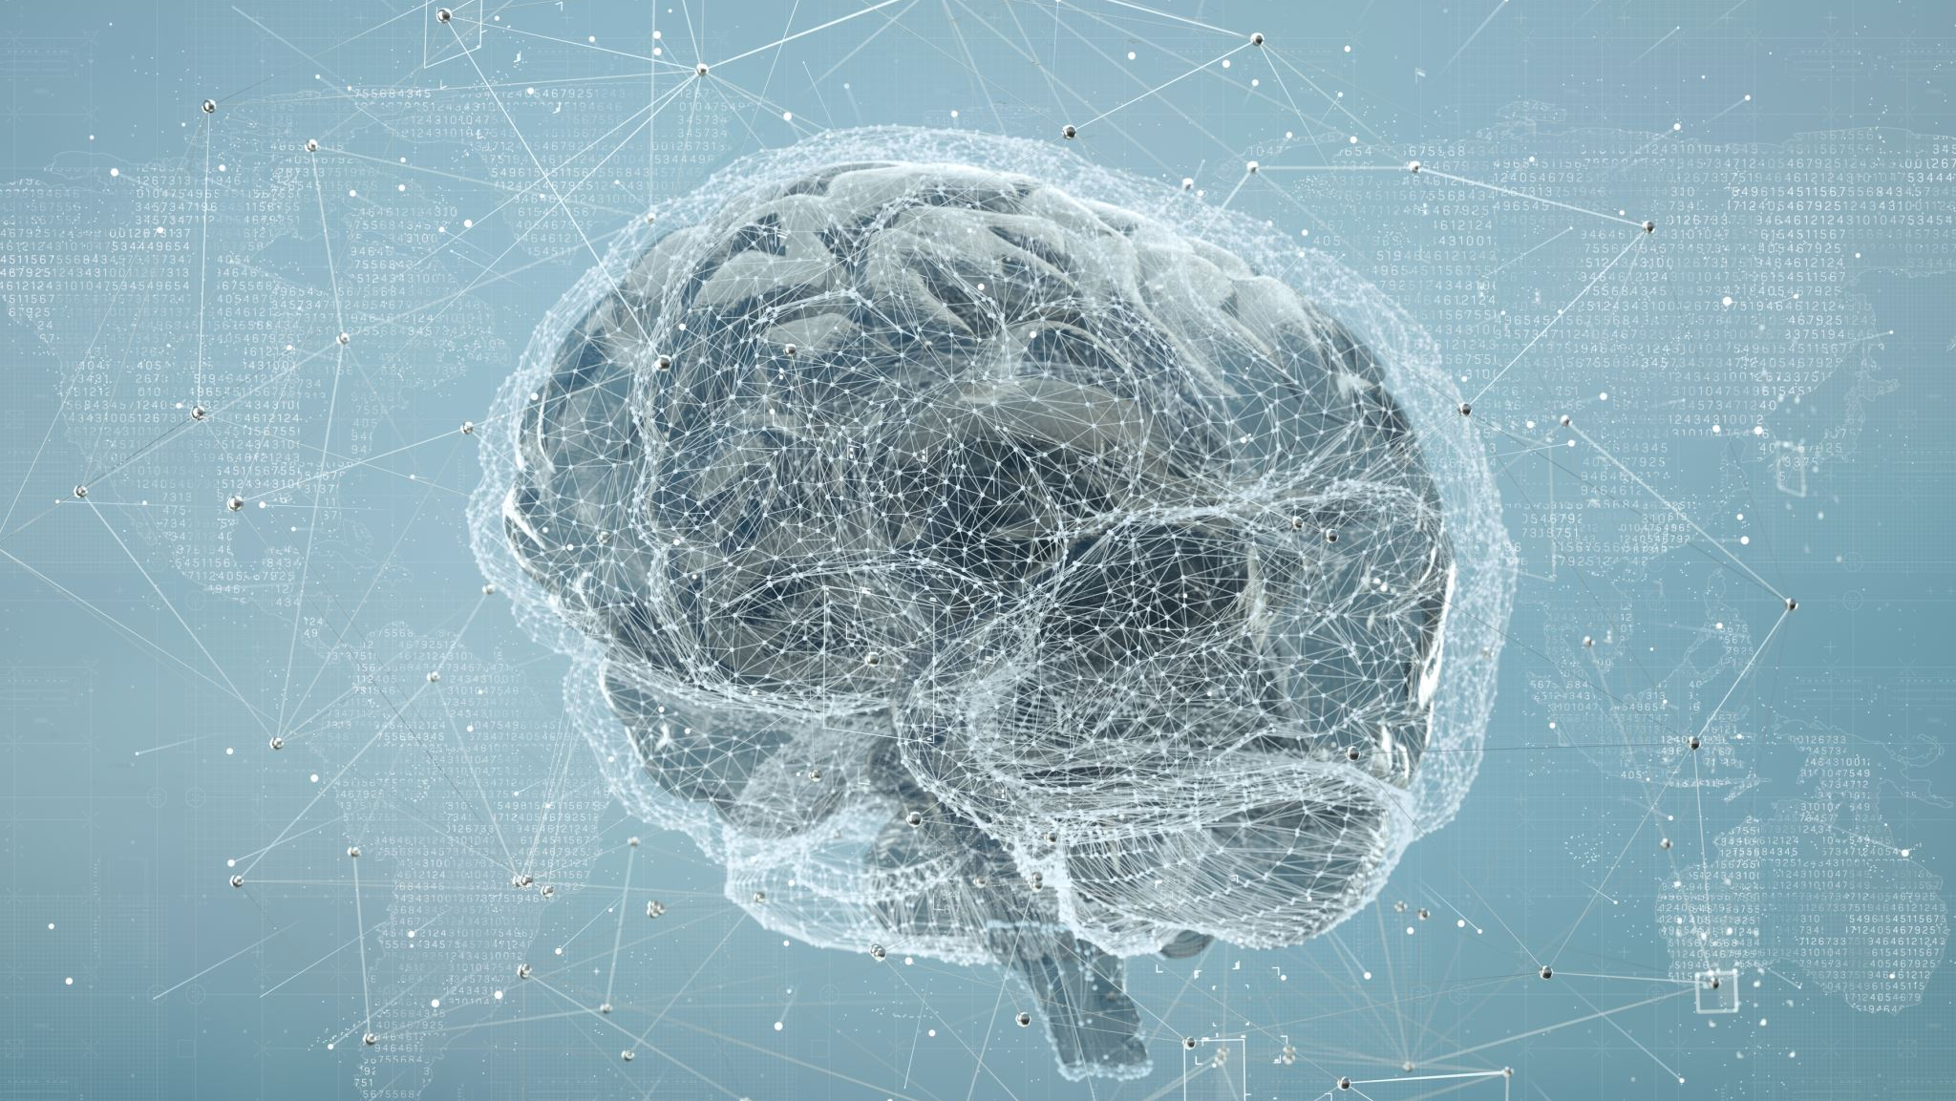
Artificial Intelligence
What is AI? What can we do with it? How can we use it responsibly?

Slide 2
What is Artificial Intelligence?
Think of Artificial Intelligence, or AI, like a robot's brain that can learn. It is a program that is written to help computers think and solve problems.
It's not alive and it’s not magic, but it can do tasks that humans do by thinking and making decisions.

Slide 3
Video from Duke University

Slide 4
How does AI learn?
AI learns by studying lots of information taken from different sources on the internet.
Just like you practice to get better at everything you do, AI practices to get smarter!
AI learns by looking at lots of examples, like pictures of cats and dogs. It starts to notice what makes a cat a cat and a dog a dog. It's kind of like how you learn to recognize animals in a book!

Slide 5
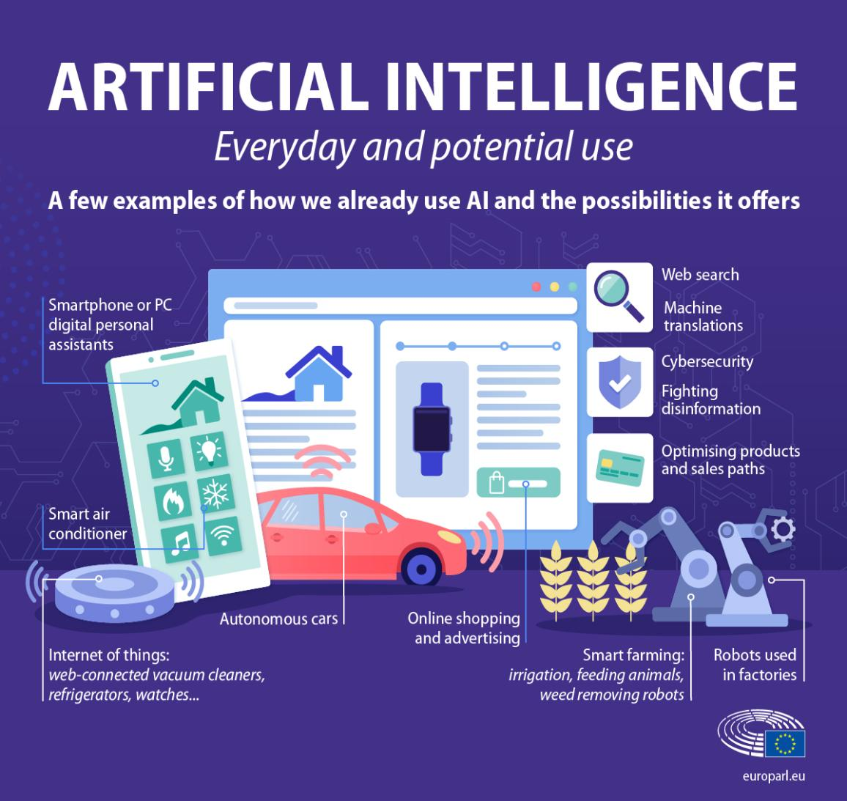
What are some examples of how we use AI that you can think of?
Photo by European Parliment
Notes:
We can use AI for many things, like helping doctors find out what makes us sick, making games more fun, and even helping us with homework. AI is a tool that can do a lot of cool things!
Spell-check, powerpoint designer are all examples of AI

Slide 6
What is Generative AI?
It is a technology-based tool that can create writing or art all own its own
Oftentimes, you can type or say what you want the AI to do, and it will help
You can even make changes if the answer wasn’t exactly what you were looking for!
This is a very popular tool that many people have started to use in their daily lives
For example: Chat GPT
Photo from pexels by Hatice Baran

Slide 7
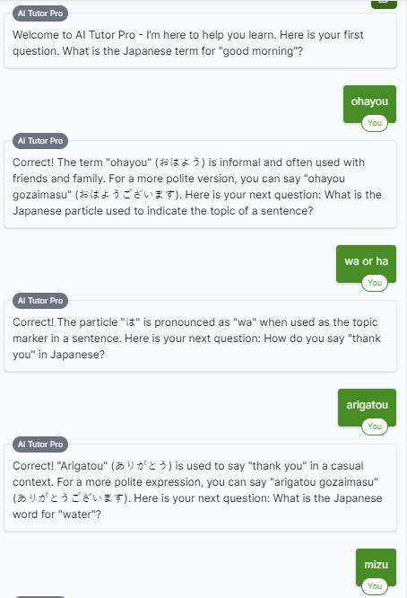
Here are some cool things Mrs. Yang can do with generative AI
I can get it to help design new lessons
I can make images faster than before
I can get help with my writing
I can start to learn new things
I can practice speaking a different language with it

Slide 8
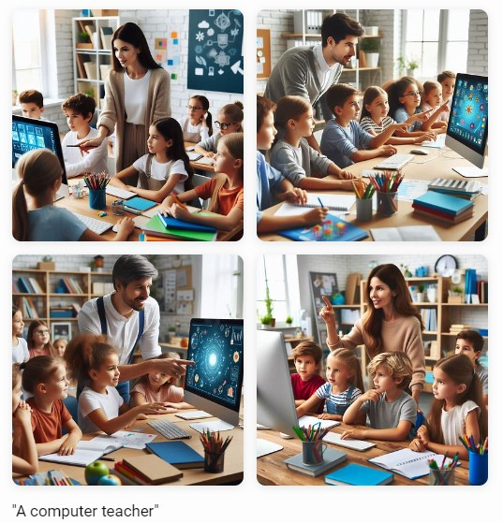
Bias in AI
AI bias is when an artificial intelligence learns from data that is not fair or balanced because it learned from unfair examples.
We must teach AI not to have biases. Software developers and AI users need to give the AI more diverse and varied information to make it less bias
Notes:
Imagine if you only learned about apples and never about oranges. You might think apples are the only fruit! AI needs to learn about all kinds of things to make good decisions.
Think of it like a parrot that repeats words it hears without knowing what they mean. If it hears unkind words, it will repeat them too.

Slide 9
Let’s talk ethics
Ethics is defined by the Canadian government as the study of “what is morally right or wrong, just or unjust” (Government of Canada, 2015)
When using AI, we must remember to always be ethical
That means:
We don’t share private information about ourselves or anyone else with an AI
We don’t use AI to cheat on tests or do assignments for us
We let our teachers know when we use AI to help us with our assignments (how did you change it?)
We are critical and using good judgement about what AI tells us
Remembering that AI is still learning so it can and will make mistakes

Slide 10
Is it ok to use AI to…
Ask for help learning about something you’re interested in?
Write a story and you tell your teacher you made it by yourself?
Make art for you and you tell everyone you made it by yourself?
Make silly pictures of animals with mixed up body parts
Add a teammate into a group team photo?
Put a picture of someone you know in a photo that would make them look bad
Ask for tips on how to beat a level in a video game?
To replace your teacher?
Notes:
Is the answer that AI gives you, your work or the AI’s?
Ai is not a person, but the answer didn’t come from you?

Slide 11
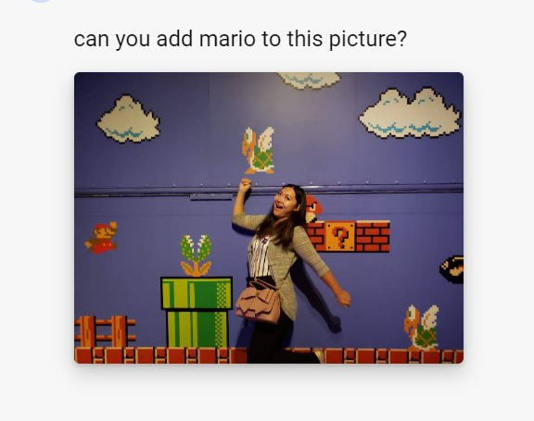
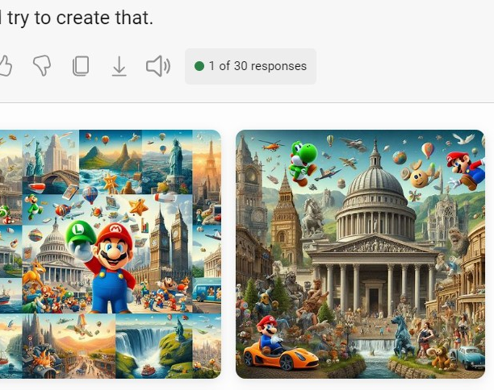
Remember AI is not perfect, but it is still pretty neat!
It is still learning and will make mistakes
It can only do simple tasks at this point – it can’t handle big jobs yet
We need to be responsible using AI
We can learn with it, but not from it
We must remember to respect others when we do use it
We must use it to help, not harm
Notes:
What is wrong with this picture?
The compass’ directions are incorrect
AI can’t follow all instructions perfectly yet (example: Adding Mario to a picture of Mrs. Yang)

Slide 12
Can I use AI at Harbour View and in my Middle School?
At this point in time, the answer is “No”
But there may come a time where this decision may change
This is a school district policy that applies to every student K-12
Online privacy and the safety of your private information is what is most important
AI systems currently keep all the information you give it (your log-in information, search terms, and modifications)
Always get permission from your family before using AI
Mrs. Yang is happy to talk to your families about AI and how it can be used responsibly ☺

Slide 13
To learn more about how AI learns, let’s play Hexapawn!
You need:
2 players
One player is the human
One player is the new AI
A 3x3 gameboard
3 red chips for the new AI
3 yellow chips for the human
container
AI needs the AI learning kit (move rule cards and coloured beads)
Scoresheet with reflection questions

Slide 14
How to win
You win by doing 1 of 3 things:
You capture all of your opponent’s pawns
You make it to the other side
You lock the game so no one can move

Slide 15
Rules of Hexapawn
Decide who will be the human and who is the newly created AI
Chips can either move forward, or move diagonally ONLY to capture another chip
Humans can choose whichever move they want
New AI must follow the written code cards
Grab a coloured bead from the code’s box to determine your move
If the game can still be played, keep playing
If you lose the game, remove the bead from the code box, and keep playing
Play several rounds – AI gets to keep the codes from the last game coming into the next game

